Slide 1

Lab 3.1 Supervised Learning in RL
Notes:
1

Slide 2
Objectives
This example demonstrates how supervised learning can be used in reinforcement learning to learn a policy directly from labeled data, without explicitly interacting with the environment during training.
Lab 3.1 Supervised Learning in RL
2
Notes:
2

Slide 3
Lab Guide Coding
Using given code
We define a simple grid world environment using the GridWorld class, where the agent can move up, down, left, or right, with a goal state at position (2, 2).
The generate_training_data function generates training data by randomly sampling state-action pairs from the environment.
Lab 3.1 Supervised Learning in RL
3
Notes:
3

Slide 4
Lab Guide Coding
Using given code
We generate a dataset of state-action pairs and train a supervised learning model (in this case, a decision tree classifier) to predict actions based on states.
Finally, we evaluate the learned policy by using the trained model to navigate the grid world and compute the total reward obtained.
Lab 3.1 Supervised Learning in RL
4
Notes:
4

Slide 5
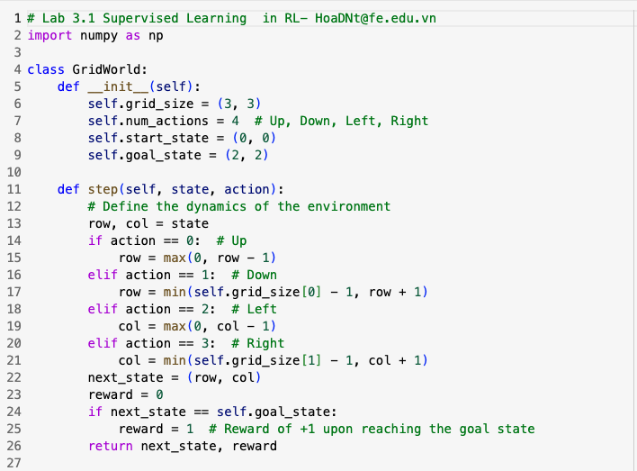
Lab Guide Coding
Lab 3.1 Supervised Learning in RL
5
Notes:
5

Slide 6
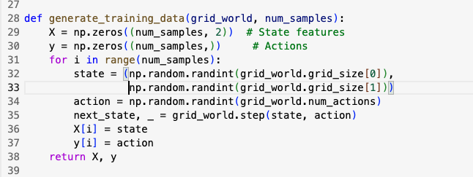
Lab Guide Coding
Lab 3.1 Supervised Learning in RL
6
Notes:
6

Slide 7
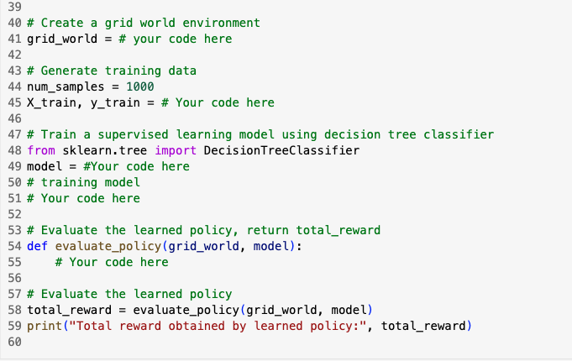
Lab Guide Coding
Lab 3.1 Supervised Learning in RL
7
Notes:
7

Slide 8
Q & A
Lab 3.1 Supervised Learning in RL
8

